Slide 1

Error Handling
Syntax, Index, Key, Type, Value, Name Errors
SoftUni Team
Technical Trainers
Software University
https://softuni.bg

Slide 2
Table of Contents
Errors and Exceptions
Common Error Types
Custom Exceptions
Catching Exceptions
Notes:
2

Slide 3
Have a Question?
sli.do
#python-advanced
Notes:
3

Slide 4

Definitions and Examples

Slide 5
What is an Error?
Every programmer encounters errors
Encountering errors and exceptions can be very frustrating at times
Once you know why you get certain types of errors, they become much easier to fix
There are (at least) two distinguishable kinds of errors
Syntax errors
Exceptions

Slide 6
Example: Errors
Syntax errors, also known as parsing errors, are perhaps the most common kind of complaint you get while you are still learning Python
The parser displays an 'arrow' pointing at the earliest point where an error was detected
>>> while True print('Hello world')
File "<stdin>", line 1
while True print('Hello world')
^
SyntaxError: invalid syntax

Slide 7
What is an Exception?
Even if a statement or expression is syntactically correct, it may cause an error when an attempt is made to execute it
Errors detected during execution are called exceptions
When an exception is not handled it results in error messages

Slide 8
Example: Exception
>>> 10 * (1/0)
Traceback (most recent call last):
File "<stdin>", line 1, in <module>
ZeroDivisionError: division by zero
>>> 4 + spam*3
Traceback (most recent call last):
File "<stdin>", line 1, in <module>
NameError: name 'spam' is not defined
>>> '2' + 2
Traceback (most recent call last):
File "<stdin>", line 1, in <module>
TypeError: Can't convert 'int' object to str implicitly

Slide 9

Common Error Types
Definitions and Examples

Slide 10
Syntax Error
A certain statement is not in accordance with the prescribed usage
It is the most common reason of an error in a Python program
>>> print "hello"
SyntaxError: Missing parentheses in call to 'print'. Did you mean print("hello")?

Slide 11
Index Error
IndexError is thrown when trying to access an item at an invalid index
>>> L1=[1,2,3]
>>> L1[3]
Traceback (most recent call last):
File "<pyshell#18>", line 1, in <module>
L1[3]
IndexError: list index out of range

Slide 12
Key Error
KeyError is thrown when a key is not found
>>> D1={'1':"aa", '2':"bb", '3':"cc"}
>>> D1['4']
Traceback (most recent call last):
File "<pyshell#15>", line 1, in <module>
D1['4']
KeyError: '4'

Slide 13
Type Error
TypeError is thrown when an operation or function is applied to an object of an inappropriate type
>>> '2'+2
Traceback (most recent call last):
File "<pyshell#23>", line 1, in <module>
'2'+2
TypeError: must be str, not int

Slide 14
Value Error
ValueError is thrown when a function's argument is of an inappropriate type
>>> int('xyz')
Traceback (most recent call last):
File "<pyshell#14>", line 1, in <module>
int('xyz')
ValueError: invalid literal for int() with base 10: 'xyz'

Slide 15
Name Error
NameError is thrown when an object could not be found
>>> age
Traceback (most recent call last):
File "<pyshell#6>", line 1, in <module>
age
NameError: name 'age' is not defined

Slide 16
Problem: So Many Exceptions
You will be provided with a code that raises many exceptions
Fix the code, so it works properly
numbers_list = input().split(", ")
result = 0
for i in range(numbers_list):
number = numbers_list[i + 1]
if number < 5:
result *= number
elif number > 5 and number > 10:
result /= number
print(result)
1, 2, 3, 4, 5, 6, 7, 8, 9, 10, 11
0.003968253968253968
# 1*2*3*4*5/6/7/8/9/10

Slide 17
Solution: So Many Exceptions
numbers_list = [int(x) for x in input().split(", ")]
result = 1
for i in range(len(numbers_list)):
number = numbers_list[i]
if number <= 5:
result *= number
elif number > 5 and number <= 10:
result /= number
print(result)

Slide 18

Custom Exceptions
Exceptions Serving Certain Purpose

Slide 19
Custom Exceptions
Sometimes you may need to create custom exceptions that serves your purpose
In Python, users can define such exceptions by creating a new class
Derived from the Exception class
class CustomError(Exception):
pass
raise CustomError
Raising the Exception

Slide 20

User-Defined Exceptions
Here we illustrate how user-defined exceptions can be used in a program to raise errors
# define Python user-defined exceptions
class Error(Exception):
"""Base class for other exceptions"""
pass
class ValueTooSmallError(Error):
"""Raised when the input value is too small"""
num = int(input())
if num < 10:
raise ValueTooSmallError

Slide 21
Problem: Value Cannot Be Negative
Create your own exception called ValueCannotBeNegative
Write a program that reads five numbers from the console (on separate lines)
If a negative number occurs, raise the exception
1
4
-5
3
10
Traceback (most recent call last):
File ".\value_cannot_be_negative.py", line 8, in <module>
raise ValueCannotBeNegative
__main__.ValueCannotBeNegative

Slide 22

Solution: Value Cannot Be Negative
class ValueCannotBeNegative(Exception):
"""Number is below zero"""
pass
for i in range(5):
number = int(input())
if number < 0:
raise ValueCannotBeNegative

Slide 23

Catching Exceptions
Try-Except-Finally

Slide 24
Catching Exceptions
It is possible to write programs that handle selected exceptions
We handle only ValueError, so if other error occurs, the error message will show up anyway
while True:
try:
x = int(input("Please enter a number: "))
break
except ValueError:
print("Oops! That was no valid number. Try again...")

Slide 25
The Try Statement
The Try statement works as follows
The try clause is executed
If no exception occurs, the except clause is skipped
If the type of the exception matches, the except clause is executed
If the exception does not match, the exception is unhandled, and execution stops with a message

Slide 26
The Except Statement
An Except clause may name multiple exceptions as a parenthesized tuple, for example
If some of these exceptions occur, the body of the except statement will be executed
except (RuntimeError, TypeError, NameError):
pass

Slide 27
The Finally Statement
If a finally clause is present, the finally clause will execute as the last task before the try statement completes
The finally clause runs whether or not the try statement produces an exception
try:
x = int("Peter")
except ValueError:
print("Cannot convert str to int")
finally:
print("Finally block")
Cannot convert str to int
Finally block

Slide 28
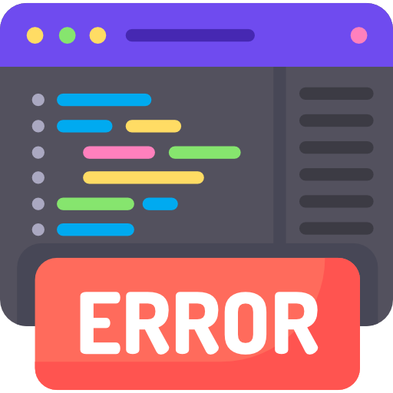
Catching the Exception Object
If you wanted to examine the exception, you can do it using the following syntax
try:
x = int(input())
except ValueError as error:
print(error)

Slide 29
Catching Multiple Exceptions
Sometimes, you want to catch all errors that could possibly be generated, but usually you don't
In most cases, you want to be as specific as possible
try:
# some code
except ValueError:
# handle the error
except TypeError:
# handle the error

Slide 30
Problem: Repeat Text
Write a program that receives text on the first line and times (to repeat the text) that must be an integer
Invalid times should be handled with exception that prints a message "Variable times must be an integer"
Hello
Bye
Variable times must be an integer
Hello
2
HelloHello

Slide 31
Solution: Repeat Text
try:
text = input()
times = int(input())
print(text * times)
except ValueError:
print("Variable times must be an integer")

Slide 32

Summary
Errors are the result of bad code
Errors detected during execution are called exceptions
Syntax, Index, Key, Type, Value, Name errors
We can build custom exceptions that serves our purpose
Handling exceptions with Try-Except block
Notes:
32

Slide 33
Questions?
Notes:
33

Slide 34












SoftUni Diamond Partners

Slide 35


Educational Partners

Slide 36
Trainings @ Software University (SoftUni)
Software University – High-Quality Education, Profession and Job for Software Developers
softuni.bg, about.softuni.bg
Software University Foundation
softuni.foundation
Software University @ Facebook
facebook.com/SoftwareUniversity
Software University Forums
forum.softuni.bg
Notes:
36

Slide 37

License
This course (slides, examples, demos, exercises, homework, documents, videos and other assets) is copyrighted content
Unauthorized copy, reproduction or use is illegal
© SoftUni – https://about.softuni.bg/
© Software University – https://softuni.bg
Notes:
37

